Slide 1
Ensemble Models and Kernel-based Methods
Notes:
1

Slide 2
Recap of supervised linear models
A weighted combination of input features can be combined to make predictions
Those predictions can be:
Regression: predicts a continuous output e.g. risk score
Classification: predicts a binary outcome e.g. disease/ no disease
These models work well when the relationship between features and outcome are approximately linear
Classification
Regression

Slide 3
Limitations of linear models
Linear models are powerful but real data is very rarely so cleanly separable.
When tackling nonlinear classification problems, linear models will misclassify.

Slide 4
Overcoming nonlinear decision boundaries
So how do we get around this?
We are going to cover 2 approaches:
Transform the data to make them linearly separable
Change the decision boundary to allow it to wrap the data

Slide 5
Learning objectives
By the end of today, you will be able to:
Explain why linear models have limitations and what strategies address them.
Understand how kernel functions allow linear models to handle non-linear data.
Describe the training behind decision trees.
Describe the difference between averaging and boosting ensemble methods.
Build and evaluate a random forest and an SVM model in code.

Slide 6
Feature Vectors
So far, we have assumed that each item we wish to classify, cluster, or process can be represented as a fixed-size feature vector.
However, for certain types of items/concepts, it is not clear how to best represent them as fixed-sized feature vectors.
For example, how do we represent a text document or protein sequence, which can be of variable length? Or a molecular structure, which has a complex 3d geometry? or an evolutionary tree, which has variable size and shape?

Slide 7
Linear separability and kernel functions
What if no straight line can separate data?
Apply a function to “change the space”
E.g. from 2D to 3D → maybe the data is now linearly separable
We can apply a function to transform the original data into a higher-dimensional space in which the data items can then be compared/processed and a division margin found!

Slide 8
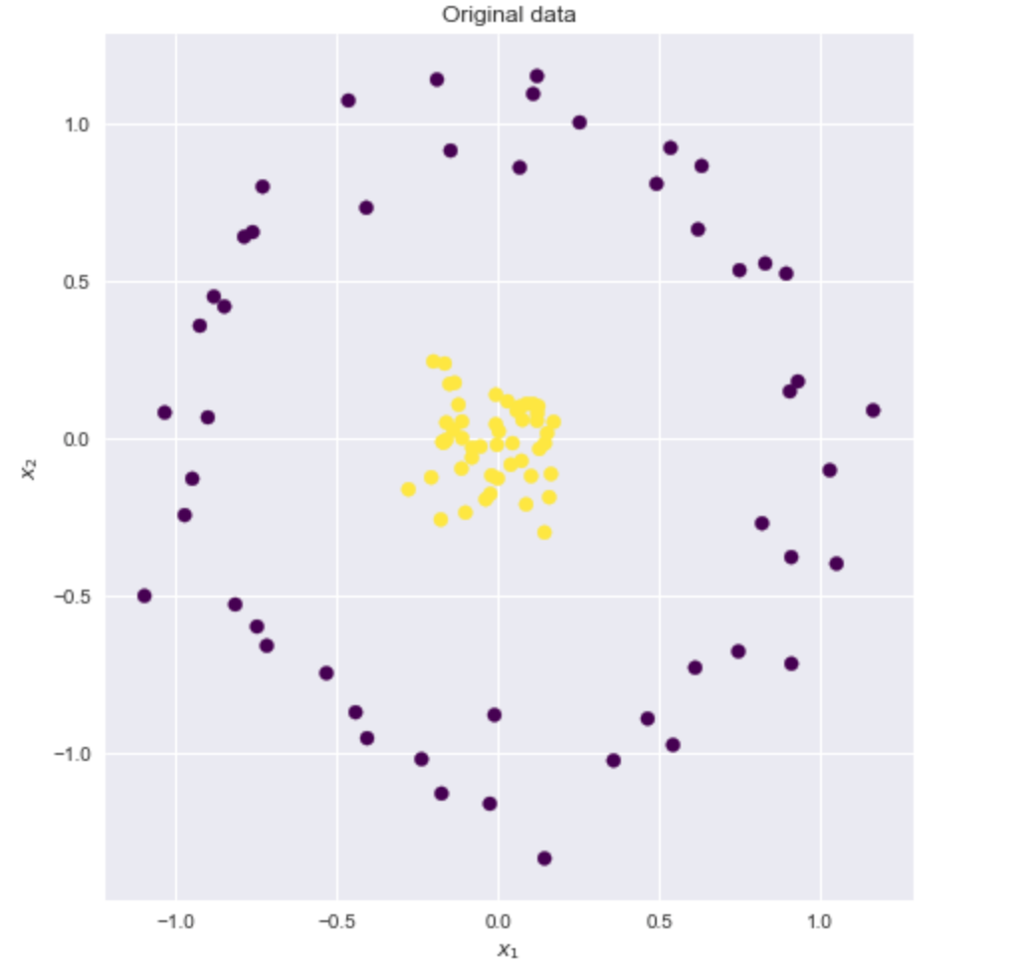
Example
Source: https://xavierbourretsicotte.github.io/Kernel_feature_map.html

Slide 9
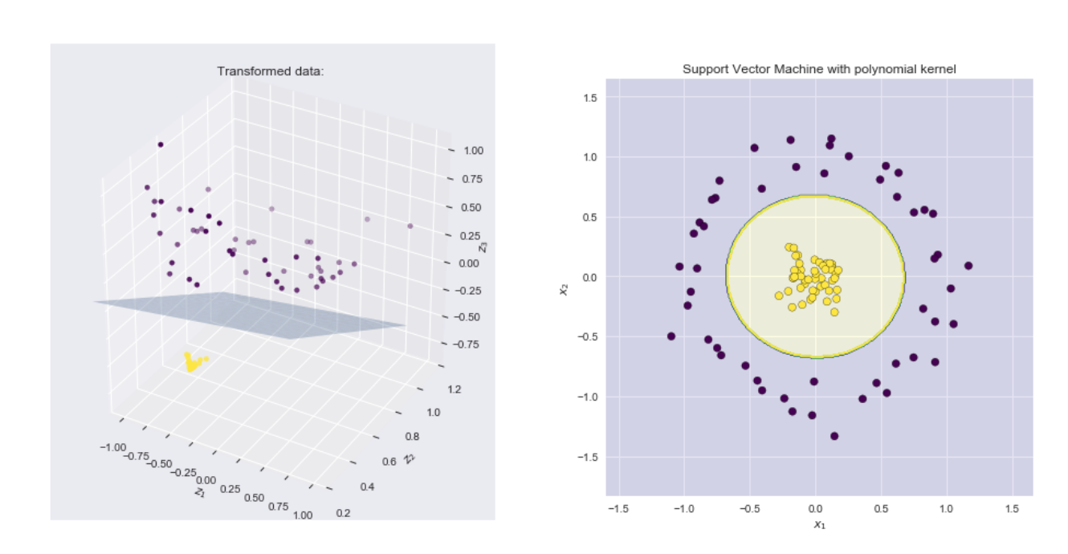
Example – applying polynomial kernel
Source: https://xavierbourretsicotte.github.io/Kernel_feature_map.html

Slide 10
What is a polynomial kernel?
If our data is a 2D set of (x₁, x₂)
Transform it to 3D (z₁,z₂,z₃) in which:
z₁ = x₁
z₂ = x₂
z₃ = x₁² + x₂²
(z1,z2,z3)= (x₁, x₂, x₁² + x₂²)
This is, in fact, the sum of polynomials

Slide 11
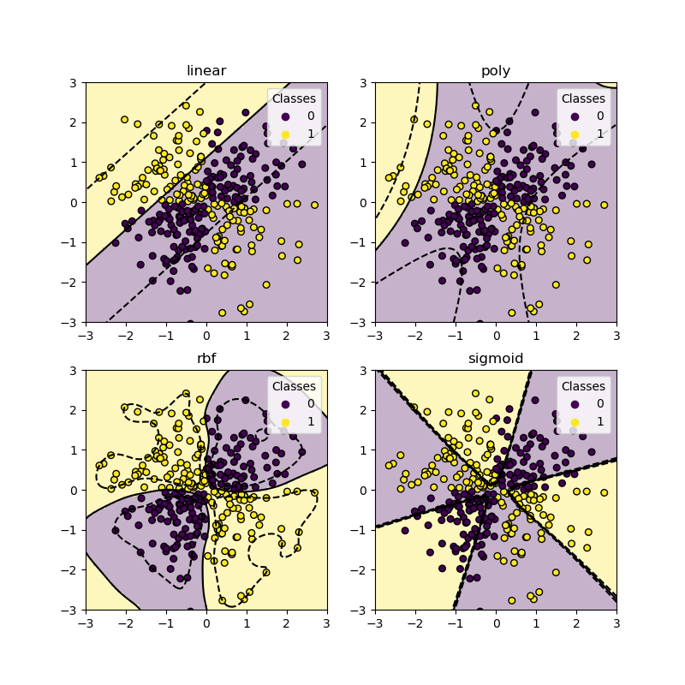
The three main kernels
Linear
Linear relationships
Straight line decision boundary
Use when data is approximately linear
Polynomial
Captures feature interactions
Produces curved boundaries
Use for moderate non-linearity
RBF (radial basis function)
Very flexible decision boundary
Most commonly used kernel
Use when structure is unknown

Slide 12
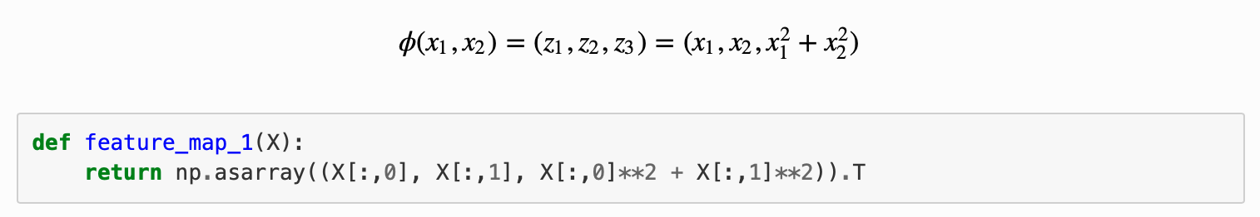
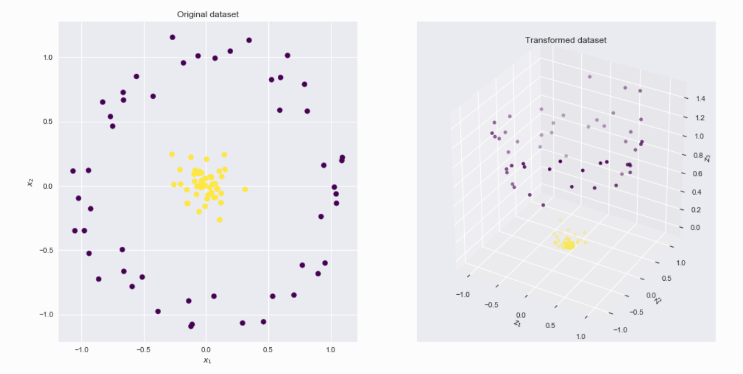
A polynomial kernel
Source: https://xavierbourretsicotte.github.io/Kernel_feature_map.html

Slide 13
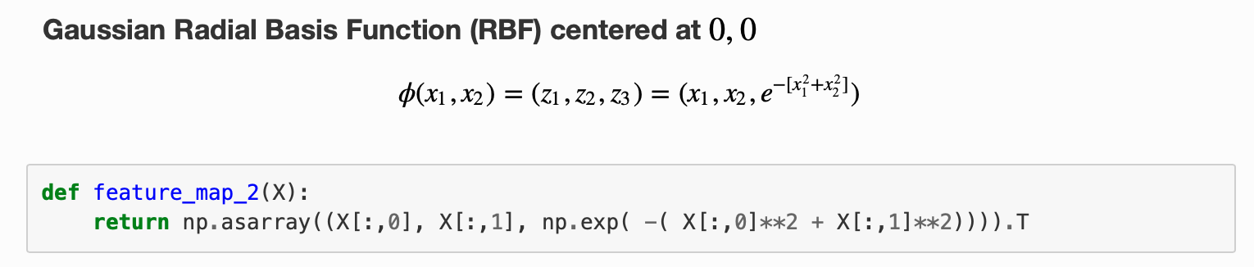
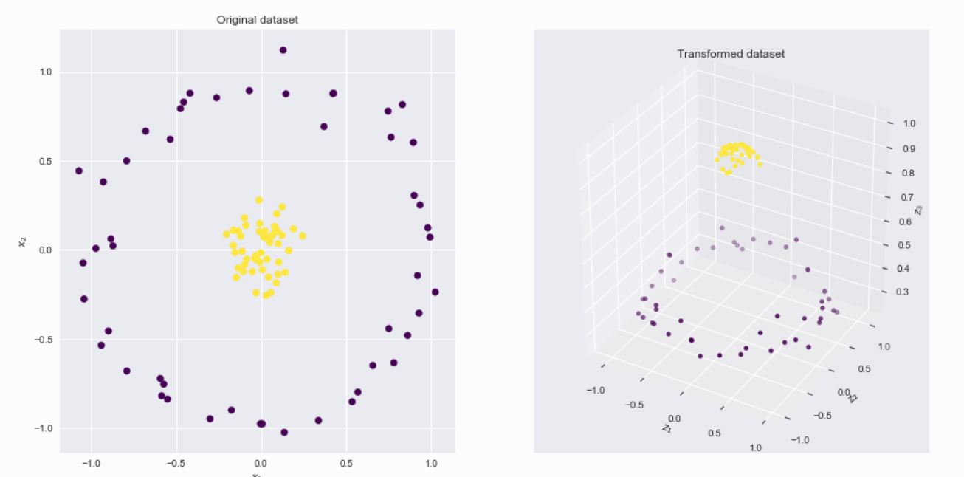
Gaussian Radial Basis Function (RBF)
Source: https://xavierbourretsicotte.github.io/Kernel_feature_map.html

Slide 14
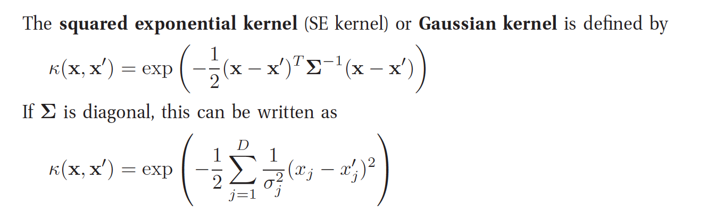
RBF Kernel in more generalised form
Source: Kevin Murphy, Machine Learning: A probabilistic Approach, MIT Press.

Slide 15
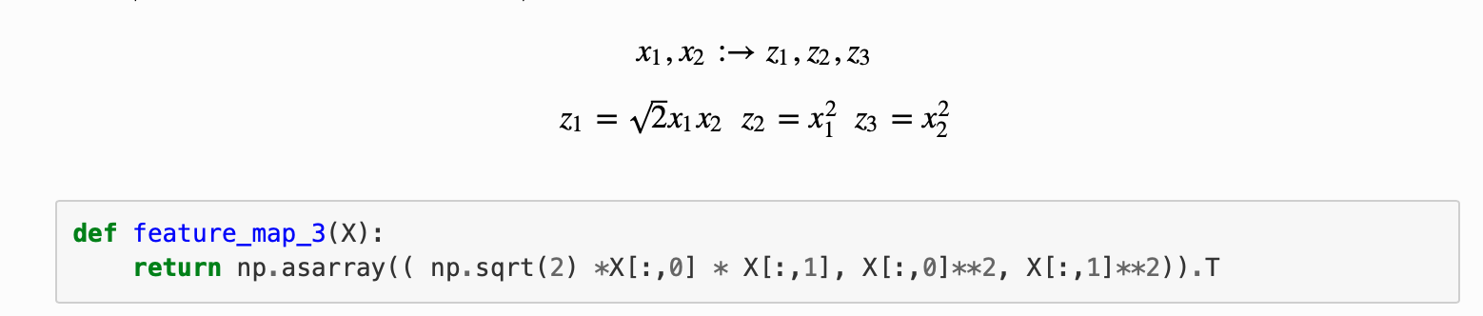
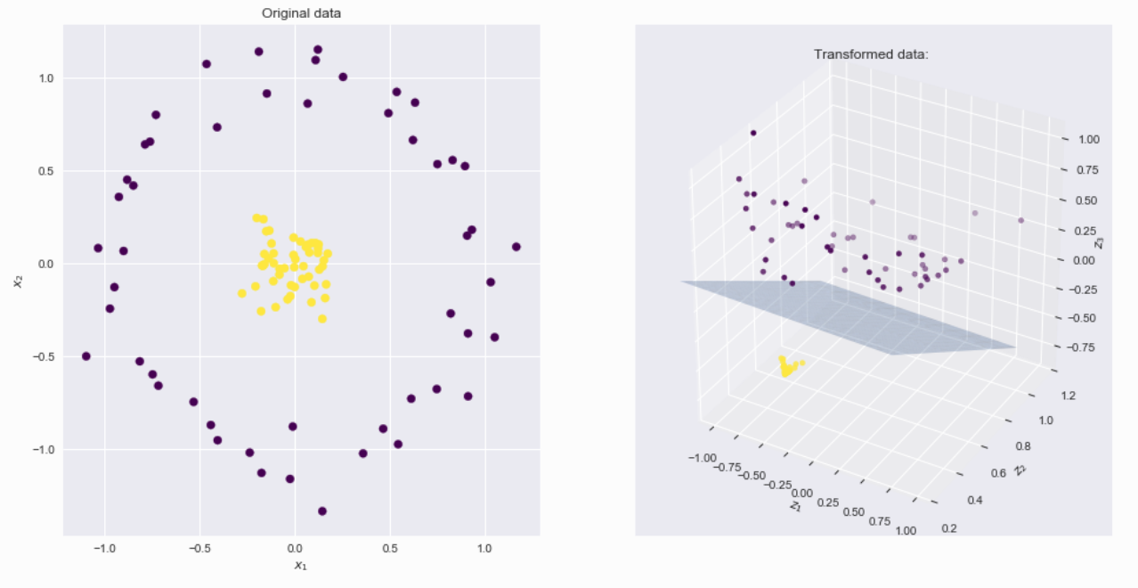
Another polynomial function
Source: https://xavierbourretsicotte.github.io/Kernel_feature_map.html

Slide 16
Kernels – quick summary
Linear → Straight boundary → Low flexibility
Polynomial → Smooth curves → Medium flexibility
RBF → Complex boundary → High flexibility

Slide 17
Support Vector Machines
Support vector machines (SVMs) are a set of supervised learning methods used for classification, regression and outlier detection.
SVM aims to choose the separating hyperplane with the largest margin
Margin: distance between the decision boundary and the closest data points
Maximise the margin to make model more robust to noise and better generalisation on unseen data, which depends on critical points called support vectors
SVM is a linear model that applies a non-linear kernel to divide non-linear data across a boundary
Source: Scikit learn documentation

Slide 18
SVM – advantages
The advantages of support vector machines are:
Effective in high-dimensional spaces.
It could still be effective in cases where the number of dimensions is greater than the number of samples.
It uses a subset of training points in the decision function (called support vectors), making it also memory-efficient.
Versatile: Different kernel functions can be specified for the decision function. Common kernels are provided, but it is also possible to define custom kernels.

Slide 19
SVM - disadvantages
The disadvantages of support vector machines include:
If the number of features exceeds the number of samples, the method will likely give poor performance.
SVMs do not directly provide probability estimates.

Slide 20
SVM Classifier
A Support Vector Machine (SVM) is a discriminative classifier formally defined by a separating hyperplane.
In other words, given labelled training data (supervised learning), the algorithm outputs an optimal hyperplane which categorises new examples.
e.g., For a linearly separable set of 2D-points which belong to one of two classes, find a separating straight line.

Slide 21
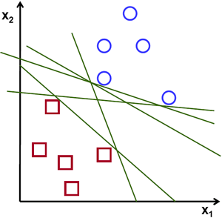
SVM Example
Source: https://vovkos.github.io/doxyrest-showcase/opencv/sphinx_rtd_theme/page_tutorial_introduction_to_svm.html

Slide 22
Linear separation
In this example, we deal with lines and points in the Cartesian plane instead of hyperplanes and vectors in a high-dimensional space.
This is a simplification of the problem.
It is important to understand that this is done only because our intuition is better built from easily imagined examples.
However, the same concepts apply to tasks where the examples to classify lie in a space whose dimension is higher than two.
Source: https://vovkos.github.io/doxyrest-showcase/opencv/sphinx_rtd_theme/page_tutorial_introduction_to_svm.html

Slide 23
SVM – linear separation
We can intuitively define a criterion to estimate the worth of the lines:
A line is bad if it passes too close to the points because it will be noise-sensitive and will not generalise correctly. Therefore, our goal should be to find the line passing as far as possible from all points.
Then, the SVM algorithm operates by finding the hyperplane that maximises the minimum distance to the training examples.
This distance is given the important name of the margin in SVM. Therefore, the optimal separating hyperplane maximises the margin of the training data.
Source: https://vovkos.github.io/doxyrest-showcase/opencv/sphinx_rtd_theme/page_tutorial_introduction_to_svm.html

Slide 24
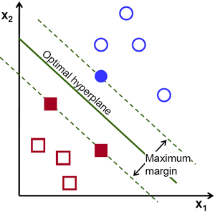
Example: SVM for a linearly separable set of 2d-points
Source: https://vovkos.github.io/doxyrest-showcase/opencv/sphinx_rtd_theme/page_tutorial_introduction_to_svm.html

Slide 25
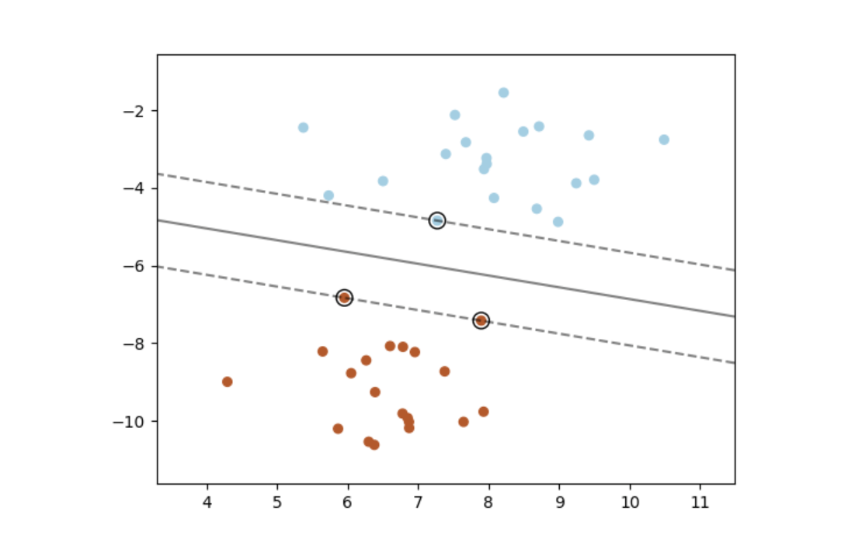
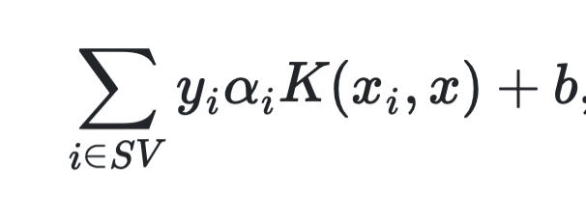
Mathematical formulation*
Source: https://scikit-learn.org/stable/modules/svm.html

Slide 26
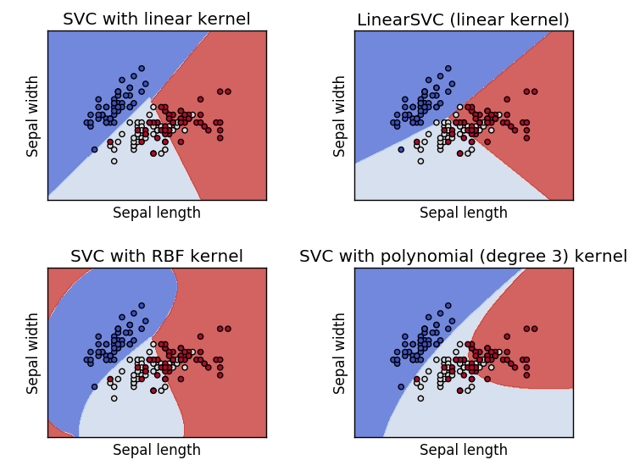
SVM with different kernels
Source: https://vovkos.github.io/doxyrest-showcase/opencv/sphinx_rtd_theme/page_tutorial_introduction_to_svm.html

Slide 27
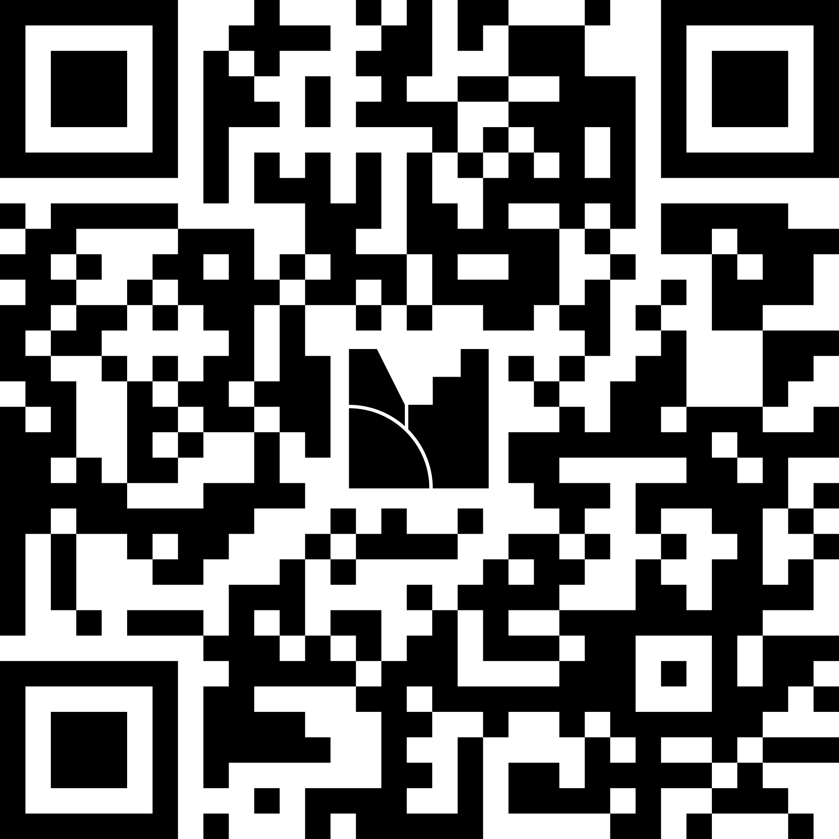
Menti meter time
https://www.menti.com/alp1axuqbv1p
Code: 4790 0935

Slide 28

Decision trees
Two approaches to overcome data that are not linearly separable:
SVM with nonlinear Kernels
Decision trees
Transform the data to make them linearly separable
Change the decision boundary to allow it to wrap the data

Slide 29
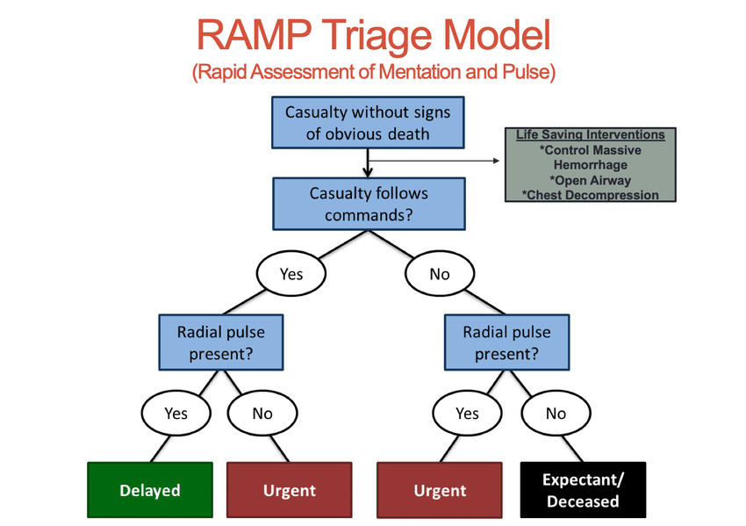
Decision Trees

Slide 30
Decision Trees
How might you use the same kind of thresholding to classify this data?
How will you tell whether the classifications are any good?
Patient | Age | BMI | Heart Rate | Disease status
1 | 31 | 20 | 60 | 0
2 | 55 | 26 | 75 | 1
3 | 70 | 23 | 50 | 1
4 | 50 | 35 | 80 | 0
5 | 35 | 30 | 100 | 1
6 | 12 | 24 | 62 | 0

Slide 31
Decision Trees
A Decision Tree (DT) model is a way of classifying data using a series of choices/criteria. The output follows a very logical “if: then, else: then” structure that makes these models inherently more interpretable.
Input values are compared against threshold values to determine the final label of the input.
DTs are made up of nodes, branches, and leaves.
Each node represents a feature, each branch a choice, and each leaf an outcome.
DTs take a top-down approach to data, attempting to group and classify similar observations and to search for optimal criteria to partition dissimilar observations until they reach a particular level of similarity.

Slide 32
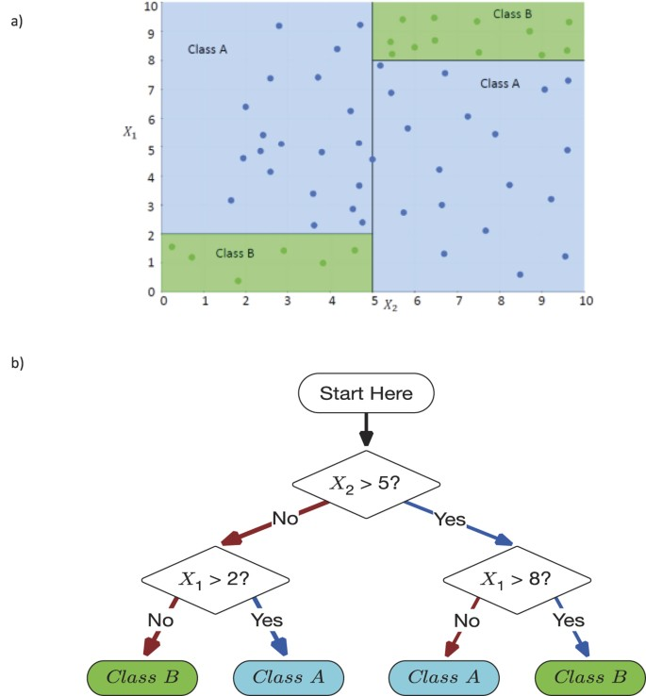
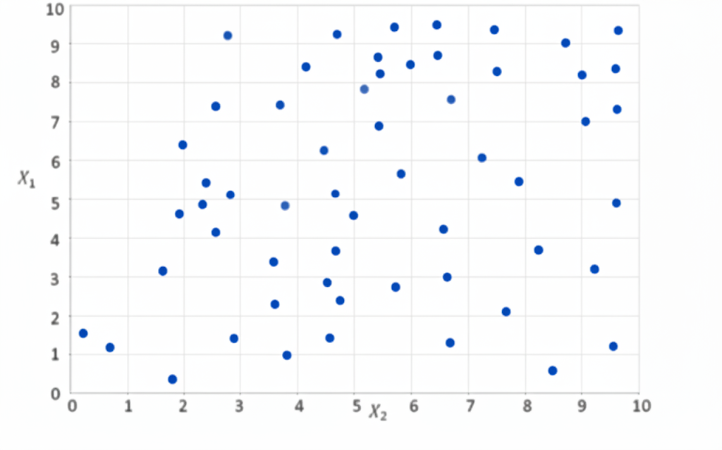
Decision Making Using DTs
Source: Valdes, G., Luna, J., Eaton, E. et al. MediBoost: a Patient Stratification Tool for Interpretable Decision Making in the Era of Precision Medicine. Sci Rep 6, 37854 (2016). https://doi.org/10.1038/srep37854

Slide 33
Decision Making Using DTs
Source: Valdes, G., Luna, J., Eaton, E. et al. MediBoost: a Patient Stratification Tool for Interpretable Decision Making in the Era of Precision Medicine. Sci Rep 6, 37854 (2016). https://doi.org/10.1038/srep37854

Slide 34
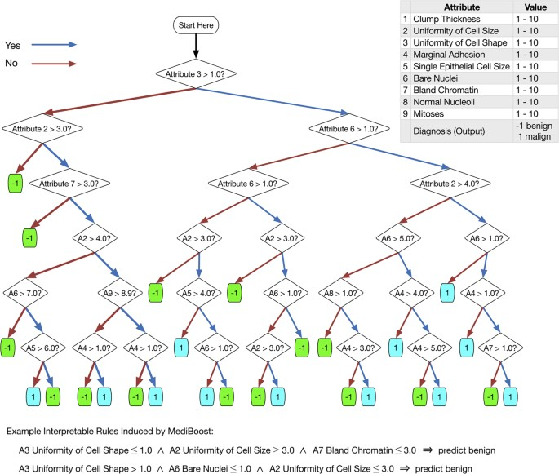
DTs in Clinical Applications
Source: Valdes, G., Luna, J., Eaton, E. et al. MediBoost: a Patient Stratification Tool for Interpretable Decision Making in the Era of Precision Medicine. Sci Rep 6, 37854 (2016). https://doi.org/10.1038/srep37854

Slide 35
Learning decision trees
There are different algorithms that can be used to learn decision tree structure from the data.
In principle, these algorithms start with a root node in the tree structure, explore the features, and create rules that separate the data one step at a time.
One of the basic algorithms is iterative dichotomiser 3 (ID3).

Slide 36

The ID3 algorithms
The tree chooses the split that produces the greatest reduction in entropy.
Entropy captures the impurity in the output with only one label being perfectly pure and a complete mix being maximally impure.
Information gain is the decrease in entropy between one level of a tree and another.
This process is formalised in the ID3 algorithm, which greedily selects the highest information gain feature at each step.
Continue the algorithm by considering only the features that have never been selected before.

Slide 37
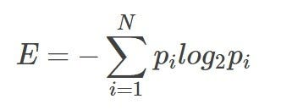
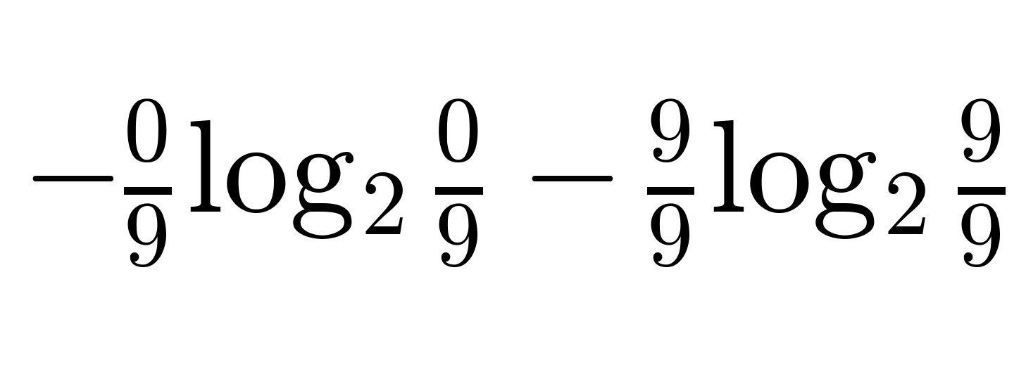
The ID3 algorithms
Entropy:
A pure node (all one class) has entropy of 0.
A perfectly mixed node has maximum entropy.
14 people
Positive Negative
9
5
Age > 50
Yes
No
Positive Negative
Positive Negative
9
0
0
5
= probability of outcome i
= 0

Slide 38
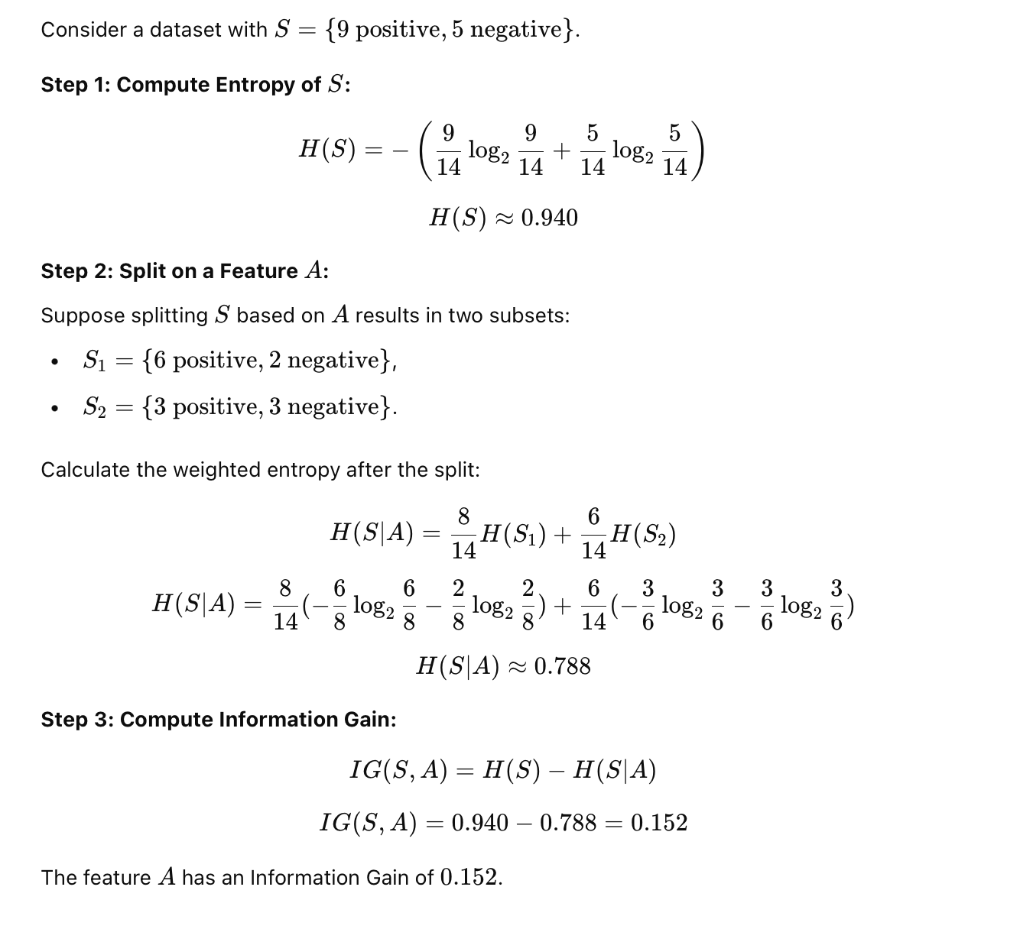
Entropy and Information Gain*
14 people
Positive Negative
9
5
Age > 50
= 0.94
Yes
No
Positive Negative
Positive Negative
6
2
3
3
Get weighted average
= 0.811
= 1
(8/14 * 0.811) + (6/14 * 1) = 0.89
weighted average entropy of bottom layer
Information gain =
Entropy of top layer –
=
0.94-0.89 = 0.05

Slide 39
Entropy and Information Gain*
But how Age < 50 was an arbitrary choice. How do we select the actual threshold value?
Subject ID | Age | Sex
1 | 25 | M
2 | 49 | F
3 | 61 | F
4 | 54 | M
5 | 39 | F

Slide 40
Decision Trees - Limitations
Prone to overfit
Poor generalisation performances
High variance
A slight change in the data can result in a completely different set of splits, which can make interpretation difficult
They can be inherently unstable
The effect of an error in the top splits propagates down to all the splits below due to their hierarchical nature
Produce biased trees for an unbalanced dataset

Slide 41
How to overcome these limitations?
Ensemble:
Single DT is fast but does not perform well
Learn from multiple trees
We need to be careful not to learn the same tree over and over again.
Averaging:
Bootstrap aggregating: Build many different versions of a model and average their predictions to get a more stable result.
Boosting:
Build models one after another, each fixing the previous one’s mistakes, to gradually improve accuracy.

Slide 42
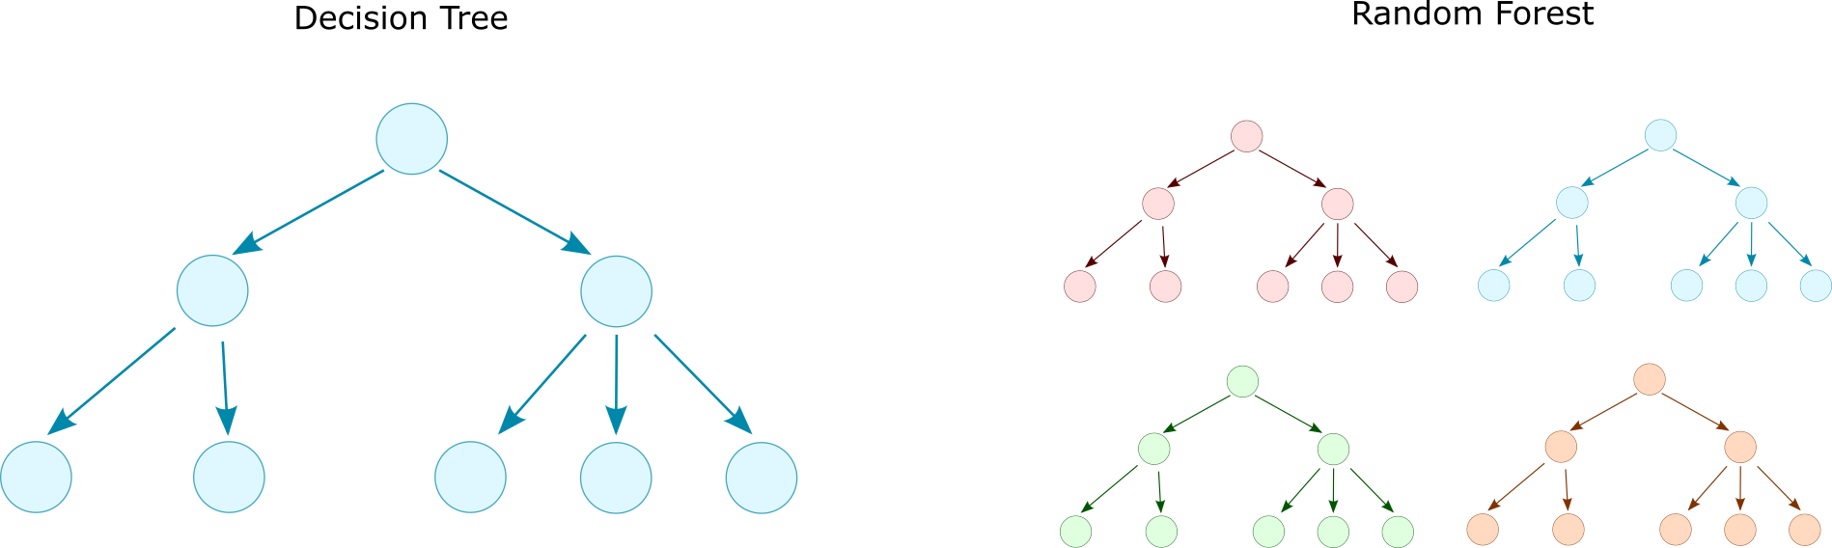
Random Forest
Random Forest was introduced in 2001 to overcome the limitations of decision trees [1].
Ensemble model consisting of multiple decision trees.
Majority vote
[1] Breiman, Leo. "Random forests." Machine learning 45.1 (2001): 5-32.

Slide 43
Averaging methods
In averaging methods, the driving principle is to build several estimators independently and then average their predictions.
The combined estimator is usually better than any single base estimator because its variance is reduced.
Examples: Bagging methods
Source: https://scikit-learn.org/stable/modules/ensemble.html

Slide 44
Bagging
There are different Bagging methods, but they mostly differ from each other in the way they draw random subsets of the training set:
When random subsets of the dataset are drawn as random subsets of the samples, then this algorithm is known as Pasting.
When samples are drawn with replacement, then the method is known as Bagging.
When random subsets of the dataset are drawn as random subsets of the features, then the method is known as Random Subspaces.
Finally, when base estimators are built on subsets of both samples and features, then the method is known as Random Patches.
In scikit-learn, bagging methods are offered as a unified BaggingClassifier meta-estimator taking as input a user-specified estimator along with parameters specifying the strategy to draw random subsets.
Source: https://scikit-learn.org/stable/modules/ensemble.html

Slide 45
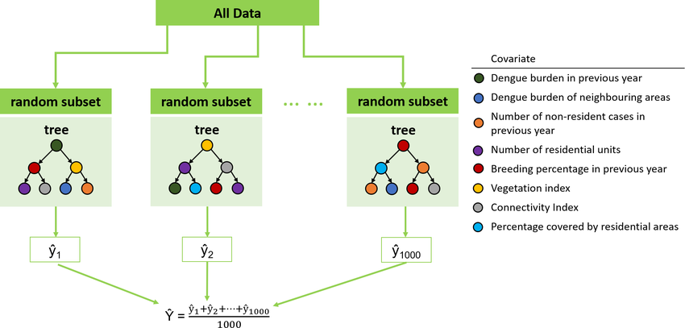
Bagging

Slide 46
Boosting methods
By contrast, in boosting methods, base estimators are built sequentially, and one tries to reduce the bias of the combined estimator.
The motivation is to combine several weak models to produce a powerful ensemble.
Examples: XGBoost, Gradient Tree Boosting
Source: https://scikit-learn.org/stable/modules/ensemble.html

Slide 47
Gradient Boosting
The term “gradient boosting” comes from the idea of “boosting” or improving a single weak model by combining it with several other weak models to generate a collectively strong model.
Gradient boosting sets targeted outcomes for the next model to minimise errors.
The outputs of each model are scaled down by a learning rate and added together to get the final prediction.
Real value = 1
+0.1
+0.2
+0.3
Predicted value = 0.4
Model 1
Model 2
Model 3
Model 4

Slide 48
XGBoost
GBDTs iteratively train an ensemble of shallow decision trees, with each iteration using the residuals from the previous model to fit the next.
The final prediction is a weighted sum of all of the tree predictions. Random forest “bagging” minimises the variance and overfitting, while GBDT “boosting” minimises the bias and underfitting.

Slide 49
Random Forests
In random forests, each tree in the ensemble is built from a sample drawn with replacement (i.e., a bootstrap sample) from the training set.
When splitting each node during the construction of a tree, the best split is found either from all input features or a random subset of size max_features.
The purpose of these two sources of randomness is to decrease the variance of the forest estimator.
Source: https://scikit-learn.org/stable/modules/ensemble.html

Slide 50
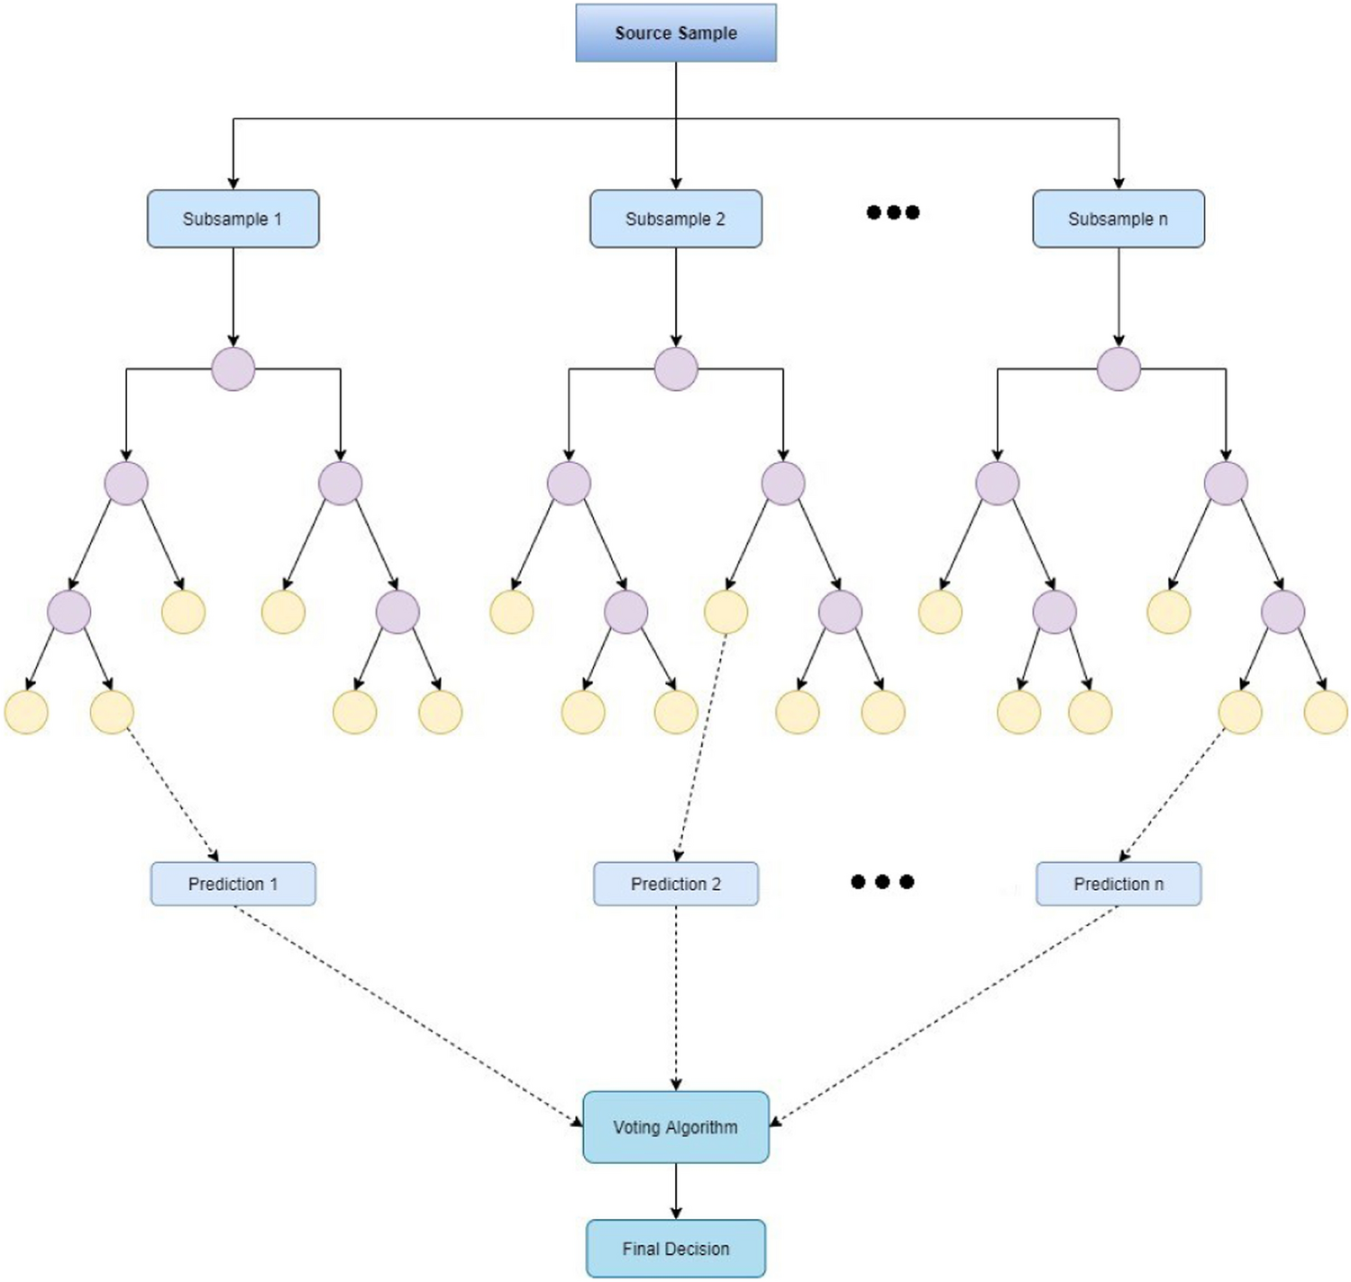
Structure of Random Forests
Source: Malebary, S.J., Khan, Y.D. Evaluating machine learning methodologies for identification of cancer driver genes. Sci Rep 11, 12281 (2021). https://doi.org/10.1038/s41598-021-91656-8

Slide 51
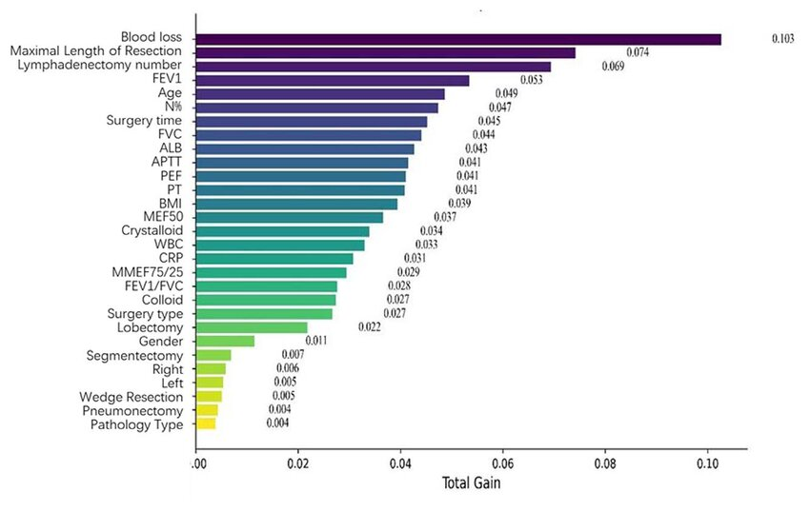
Feature important in RF: Example
Every time a feature is used to split a node, the algorithm measures how much that split reduces impurity.
These reductions are summed over all trees.
Feature importance ranking of the random forest. The importance ranking... | Download Scientific Diagram

Slide 52
Random Forests
Individual decision trees typically exhibit high variance and tend to overfit.
The injected randomness in forests yields decision trees with somewhat decoupled prediction errors.
By averaging those predictions, some errors can cancel each other out. Random forests achieve a reduced variance by combining diverse trees, sometimes at the cost of a slight increase in bias.
Source: https://scikit-learn.org/stable/modules/ensemble.html

Slide 53
Practical note on RFs
In practice, variance reduction is often significant, yielding a better overall model.
In contrast to the original publication, the scikit-learn implementation combines classifiers by averaging their probabilistic predictions rather than letting each classifier vote for a single class.
Source: https://scikit-learn.org/stable/modules/ensemble.html

Slide 54
Menti meter time
https://www.menti.com/alp1axuqbv1p
Code: 4790 0935

Slide 55
Open discussion
A research team is building a predictive model to estimate the progression of Parkinson’s disease using patient data (motor scores, speech patterns, imaging features).
Ensemble Models:
How could Random Forests or Gradient Boosting improve prediction accuracy compared to a single decision tree?
What trade-offs exist between interpretability and performance in clinical settings?
Kernel-Based Methods:
Could an SVM with an RBF kernel capture non-linear relationships in complex neurological data?
How do we choose between kernel-based methods and ensemble models for this problem?
Ethical & Practical Considerations:
Which approach is more robust to small sample sizes often seen in medical research?
How do we ensure fairness and avoid bias when using these methods on diverse patient populations?

Slide 56
The ML Roadmap

Slide 57
Step 1: Define the problem
What is the problem?
What are you predicting?
Classification (categorical predicted value) or regression (continuous predicted value)?
What does a successful model look like? (Think of evaluation metrics)

Slide 58
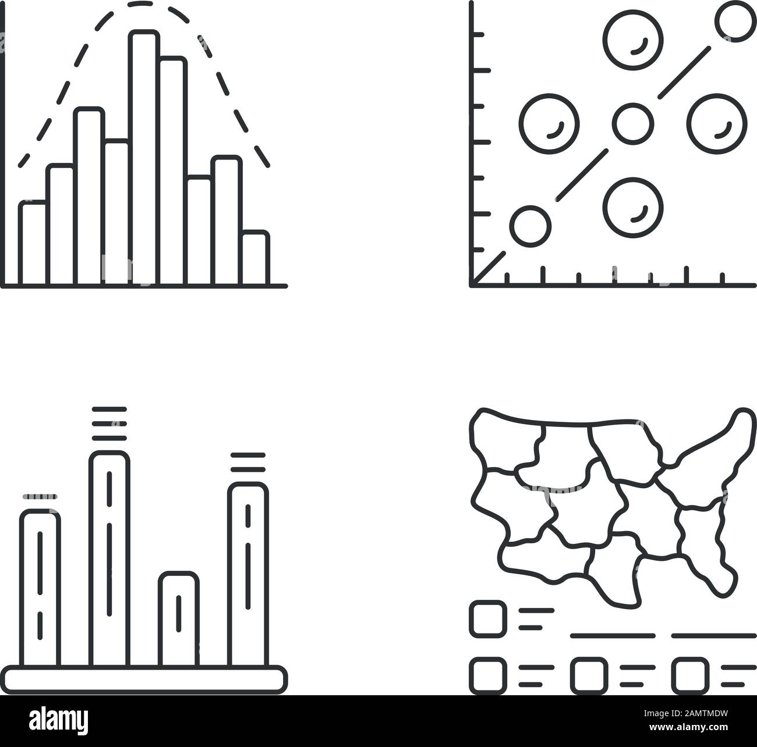
Step 2: Collect & Understand Data
Gather relevant data
Explore distributions
Check for missing values
Understand features
Simple statistical descriptive analysis

Slide 59
Step 3: Clean & Preprocess
Handle missing values
Can you remove them? Are they missing at random, or does the missingness mean something?
Normalize / scale features
Features should be on same scale so that naturally larger values don’t overpower smaller ones
Encode categorical variables
E.g. instead of a column with male and female, represent in a binary (0/1) format, so that models can understand the meaning
Split into train/test sets
What size do you want your sets?

Slide 60
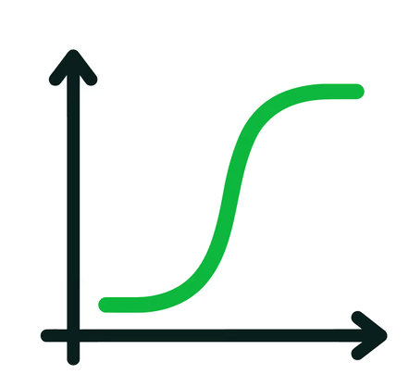
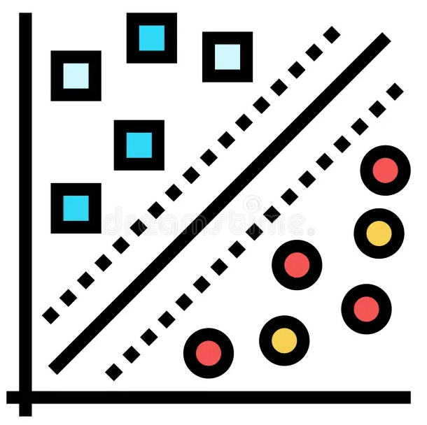
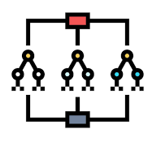
Step 4: Choose a Model
Linear regression
Logistic regression
SVM
Decision trees
Random Forest
Choose based on data and complexity

Slide 61
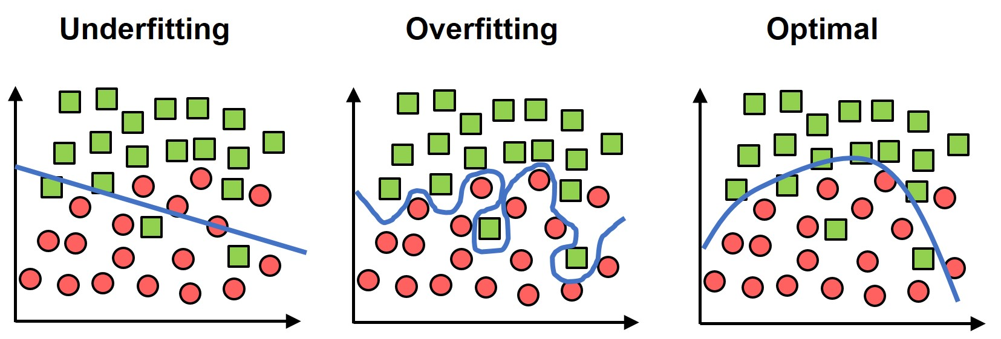
Step 5: Train the model
Fit model to training data
Optimize parameters
Avoid overfitting!

Slide 62
Step 6: Evaluate
Use test data
Metrics: Accuracy, precision, sensitivity, specificity, AU-ROC…
Cross-validation
Who did we not correctly identify? Are there any patterns?

